Slide 1

Dr .D.Y. Patil College of Engineering an Innovation Talegaon,Varale.
Department of Computer Engineering
Project Title
on
“Microcontroller based Automatic Sun tracking Solar Panel”

Slide 2

Dr. D. Y. Patil College of Engineering & Innovation, Varale, Talegaon, Pune
Project Title
Microcontroller based Automatic Sun tracking Solar Panel.
Presented By:
Mr. Chavan Raghav Sudhir 14107
Mr. Shirsath Gaurav Devendra 14155
Mr. Thore Rohan Balasaheb 14158
Mr. Wadgane Deepak Govardhan 14162
Project Guide:
Prof. Chandan Wagh

Slide 3
Contents
Abstract
Introduction
Literature survey
Block Diagram
Work Flow
Current Implementation
Conclusion
Future Scope
Reference

Slide 4
Abstract
Increase Energy Production: Dual-axis solar panel can continuously adjust their orientation to face the sun, maximizing the amount of sunlight they receive. This leads to significantly higher energy production compared to fixed panels, especially in regions with varying solar angles and seasons.
Higher Energy Density: Dual-axis tracking can significantly increase the energy density of solar installation. This means that more energy can be generated from a given area, making it suitable for location with limited available spaces.
Grid flexibility: Dual-axis tracking helps align the solar panels with the electricity demands curve, making it easier to integrate solar power into grid and potentially reducing the needs for energy storage or backup power sources

Slide 5
Introduction
Solar panels are a key component of these systems, converting sunlight into electricity. However, the efficiency of solar panels is heavily dependent on their orientation relative to the sun.
The "Microcontroller-Based Automatic Sun tracking Solar Panel" project introduces an innovative solution to enhance the efficiency of solar energy harvesting.
This project aims to design and develop a system that autonomously adjusts the orientation of solar panels in real time, ensuring that they are always aligned with the sun's position.

Slide 6
Literature Survey
Study Title | Authors | Methodology & Key Findings
“Solar panel sun tracking system: Review of Design and Implementation." | K. N. Nwaobi, C. A. Okeke & P. E. Ugwuoke | -K. N. Nwaobi, C. A. Okeke, and P. E. Ugwuoke. "Solar Panel Sun Tracking System: Review of Design and Implementation." International Journal of Advanced Research in Electrical, Electronics and Instrumentation Engineering, Volume 6, Issue 5, May 2019.
“Solar Tracking System for power Optimization using Microcontroller " | Prabhat Kumar , Vijay Kr. Garg, & S. Chatterji | - Prabhat Kumar, Vijay Kr. Garg, and S. Chatterji. "Solar Tracking System for Power Optimization Using Microcontroller." International Journal of Advanced Research in Computer Science and Software Engineering, Volume 4, Issue 6, June 2020..
“a tracking system using solar panels” | Chaiko and Rizk | -Chaiko and Rizkdeveloped a tracking system using solar panels efficiently. They designed a simple single axis tracking system using stepper motor and light sensorThey observed that this system stretches the efficiency of power collection by keeping a solar panel perpendicular to the sun rays
“Solar Tracking System using Microcontroller" | Priyanjan Sharma Nitesh Malhotra | - Priyanjan Sharma Nitesh Malhotra “ Solar Tracking System using Microcontroller” Proceedings of 2014 1st International Conference on Non Conventional Energy (ICONCE 2014) (77-79) 978-1-4799-3340- 2/14/$31.00 ©2014 IEEE

Slide 7
Study Title | Authors | Methodology & Key Findings
“horizontal single-axis tracked solar panels” | Guiha Li, Runsheng Tang, Hao Zhong | . Guiha Li, Runsheng Tang, Hao Zhong investigated horizontal single-axis tracked solar panels. They obtained result as east-west axis tracking was poor to improve the energy while tracking the sun about south-north was best.
“detailed circuit of sun tracking solar panel” | Siti Amely Jumaat | -]Siti Amely Jumaat has a detailed circuit of sun tracking solar panel. They also showed that the solar panel can also be integrated with embedded systems which makes it complex and has high cost
“Solar Energy Measurement Using Arduino” | Jumaat and Othman | -Jumaat and Othman (2018) the research paper entitled “Solar Energy Measurement Using Arduino” has used Arduino Board Technology for developing a measurement of solar energy. For the same purpose, four parameters viz temperature, light intensity, voltage and current have been used and measured by temperature sensor, light dependent resistor sensor,
“Arduino Based Solar Tracking System For Energy Improvement Of PV Solar Panel” | Aigboviosa et al | -Aigboviosa et al (2018) the research paper entitled “Arduino Based Solar Tracking System For Energy Improvement Of PV Solar Panel” defines the need to improve the energy efficiency of PV solar panel using Arduino mechanism in controlling the movement of solar panel

Slide 8
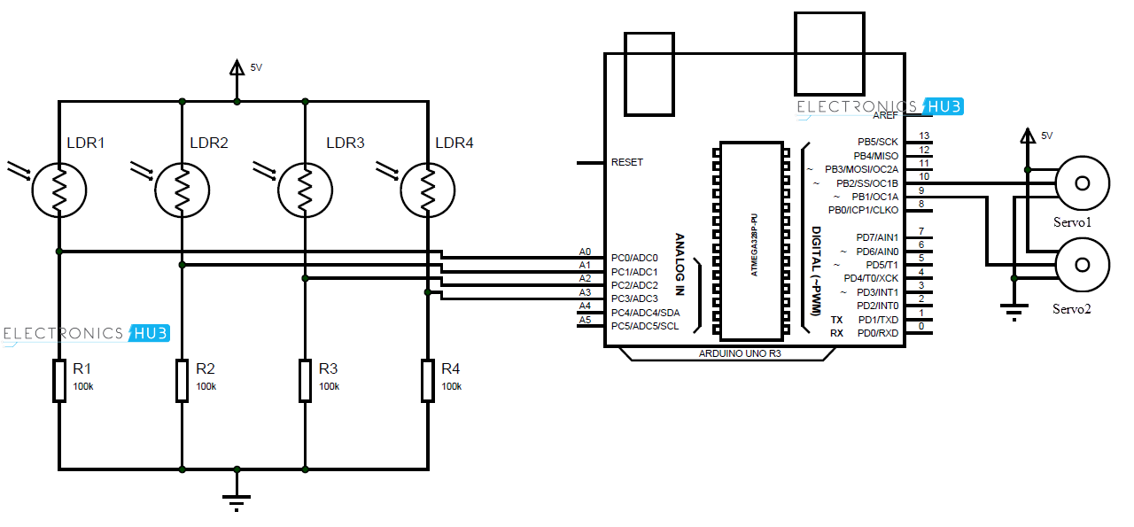
Circuit Diagram
fig. no 1

Slide 9
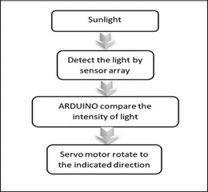
Work Flow
Fig.no 2

Slide 10
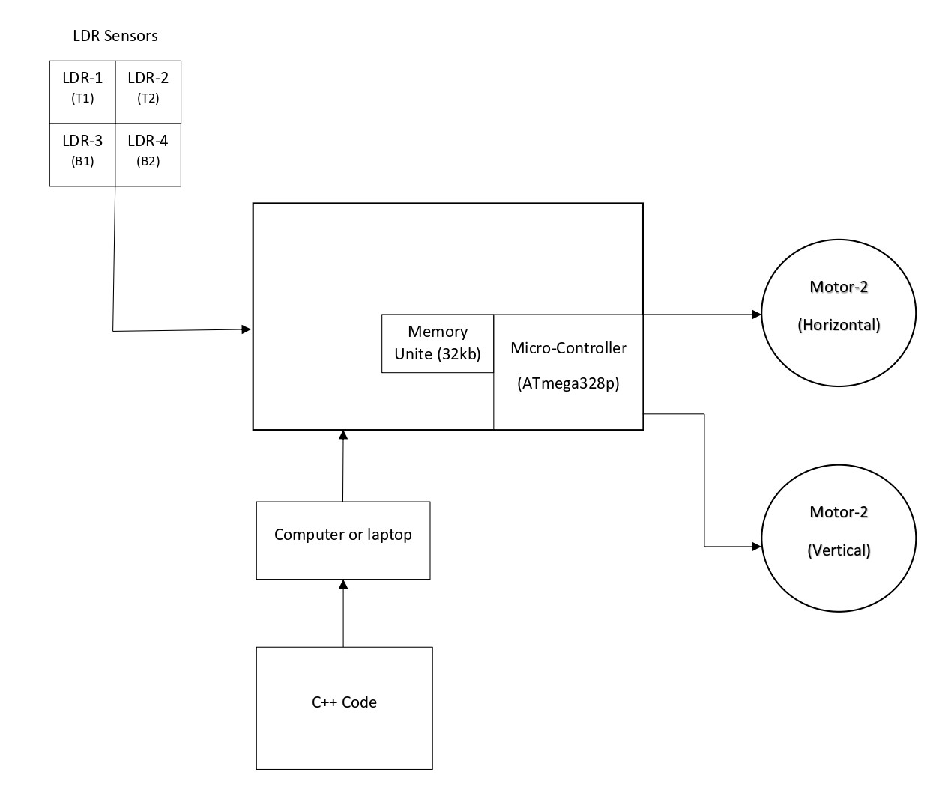
Block Diagram
Arduino UNO R3
Fig.no 3

Slide 11
Current Implementation
Notable Implementations
Solar Power Plants:
Gemini Solar Project (USA): One of the largest solar power projects in the United States, located in Nevada, incorporates dual-axis trackers to optimize energy generation.
Vanguard Solar Energy Project (Spain): Uses dual-axis tracking to increase energy output and improve efficiency in the country's solar farms.
Desert Sunlight Solar Farm (USA): Located in California's Mojave Desert, this facility uses advanced tracking systems to maximize solar energy capture.
Research and Development Centers:
National Renewable Energy Laboratory (NREL, USA): Uses dual-axis trackers in experimental setups to study and improve solar panel efficiency.
Fraunhofer Institute for Solar Energy Systems (Germany): Utilizes dual-axis tracking in various research projects focused on optimizing solar technology.
Commercial and Residential Installations:
High-Efficiency Residential Systems: Some premium residential solar installations in regions with high solar irradiance use dual-axis trackers to maximize energy capture, although this is less common due to cost considerations.
Corporate and Industrial Solar Installations: Businesses looking to maximize their renewable energy output may invest in dual-axis tracking systems.

Slide 12
Conclusion
The system's ability to autonomously track the sun's movement has led to a significant increase in energy output compared to fixed solar panel installations. By continuously aligning the panels with the sun, the system has harnessed a greater portion of available sunlight.
The project has served as an educational tool, providing insights into microcontroller programming, sensor integration, and mechanical design. It has inspired learning and innovation in the realm of renewable energy technologies.

Slide 13
Future scope
As technology advances, the cost and complexity of dual-axis tracking systems are expected to decrease. Innovations in materials, control systems, and predictive algorithms could make dual-axis trackers more accessible and efficient. This may lead to broader adoption, particularly as the global emphasis on renewable energy intensifies.
Advanced Tracking Algorithms: Enhance the tracking algorithm by incorporating more complex calculations, considering factors like atmospheric conditions, cloud cover, and seasonal variations. This could lead to even more accurate and efficient sun tracking.
Hybrid Energy System: Combining solar Tracking with other renewable energy sources like wind or hydropower can lead to the development of Hybrid energy system that provides continuous and stable power generation
Dual-Axis Tracking: Consider upgrading the system to dual-axis tracking, which includes vertical as well as horizontal movement. Dual-axis tracking can capture sunlight from a wider range of angles, further improving energy capture.

Slide 14
References
[1] F. Harashima and H. Inaba, “Microprocessor- Controlled SIT Inverter for Solar Energy System”, IEEE Trans. On Industrial Electronics, vol. IE-34, no. 1, pp50-55, Feb. 1985.
[2] C.R.Sullivan and M.J.Powers, “A High-Efficiency Maximum Power Point Tracking for Photovoltaic Arrays in a Solar-Power Race Vehicle”, IEEEPESC‘93, pp.574-580, 1993.
[3] N. Femia,D. Granozio,G. Petrone,G. Spagnuolo, “Smart Sun Tracking System”, IEEE, TRANSACTIONS ON AEROSPACE AND ELECTRONIC SYSTEMS, Vol. 42, NO. 3 JULY 2006.

Slide 15
[4] Omar Aliman, Ismail Daut, “Rotation-Elevation of Sun Tracking Mode to Gain High Concentration Solar Energy”, IEEE Conference, 12-14, Page(s):551 – 555, April 2007.
[5] A. Kassem M. Hamad, “A microcontroller-based multifunction solar tracking system”, IEEE International Systems Conference, Pages: 13 – 16,DOI:10.1109/SYSCON,2011.
[6] S. Racharla, K. Rajan and K. R. S. Kumar, "A fuzzy logic controlled single axis solar tracking system", Applied Mechanics and Materials, vol. 787, pp. 893-898, Aug. 2015.
[7] S. Yilmaz et al., "Design of two axes sun tracking controller with analytically solar radiation calculation", Renewable and Sustainable Energy Reviews, vol. 43, pp. 997-1005, Mar. 2015.

Slide 16
[8] M. Alam, M. A. Dewan, S. S. Bashar, M. S. Miah and A. Ghosh, "A Microcontroller Based Dual Axis Tracking System for Solar Panel", 2019 3rd International Conference on Electrical Computer & Telecommunication Engineering (ICECTE), pp. 25-28, 2019.
[9] M. Nageh, M. P. Abdullah and B. Yousef, "Energy Gain between Automatic and Manual Solar Tracking Strategies in Large Scale Solar Photovoltaic System-12 Cities Comparison", 2021 IEEE International Conference in Power Engineering Application (ICPEA), pp. 121-126, 2021.
[10] STANLEY R. BULL, “Renewable Energy Today and Tomorrow”, . 8, AUGUST 2001, PROCEEDINGS OF THE IEEE, VOL. 89, NO. 8.

Slide 17
Thank You !!

